Slide 1
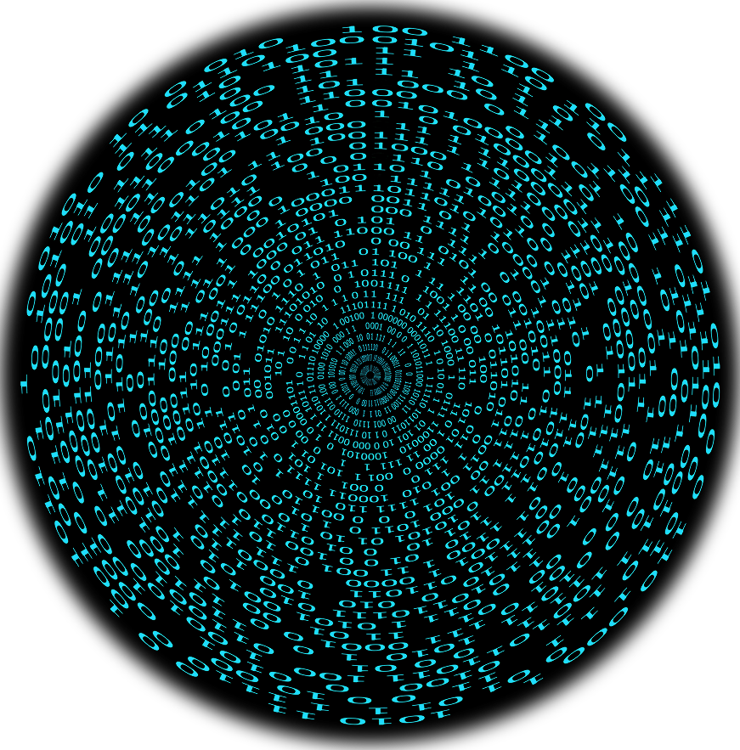

AI Academy Capstone – Found in a Random Forest
February 3, 2023

Slide 2
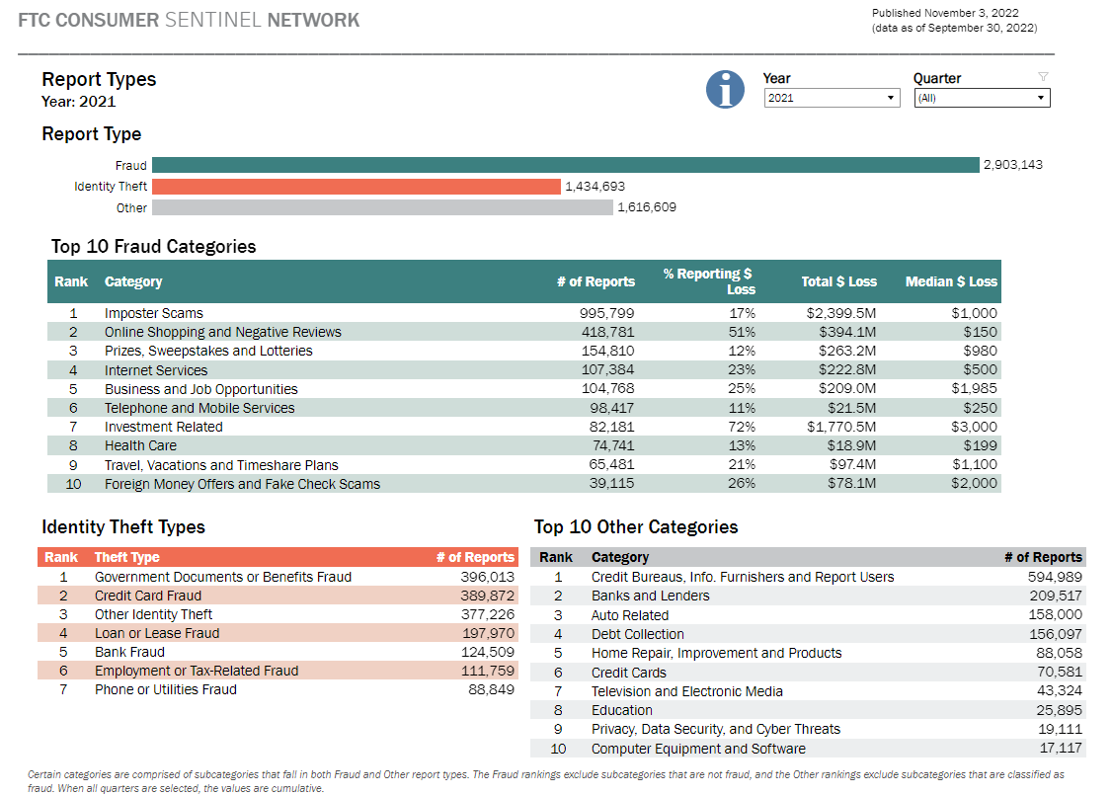
How prevalent is financial fraud?
Organizations, governments, and private citizens are at risk of becoming victims of fraud.
More than $5.8 billion was lost due to report fraud.
~ 390,000 reports of credit card fraud.
Financial institutions aren’t the only organizations impacted.
Source: FTC Consumer Sentinel Network, 2022

Slide 3
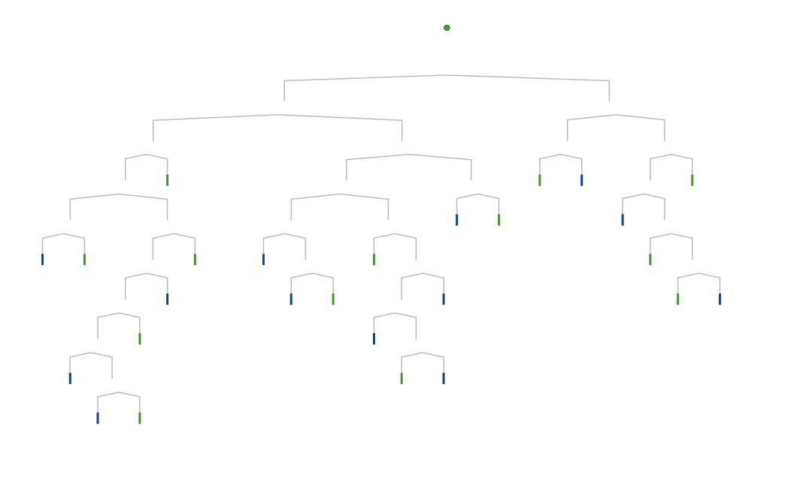
What data set was used and what models were utilized?
The decision tree and random forest analytical module were trained on a real-world credit card transaction data set.
Credit Card Fraud Detection (Kaggle)
Features of the Data Set
The dataset used contains transactions made by credit cards in September 2013 by European cardholders.
The dataset presents 284,807 transactions, of which 492 were fraudulent.
28 of 30 features have already undergone a PCA transformation.
Due to confidentiality reasons, the only labeled features are 'Time' and 'Amount', which are the two that have not undergone PCA.
The 'Class’ feature is the response variable.
Modules
Decision Tree Analytical Module
Random Forest Analytical Module
Supervised machine learning algorithm.
A decision tree is a flowchart-like structure in which each internal node represents a test on a feature.
Each leaf node represents a class label.
Great for classification problems and predictive analysis as they break down complex data into more manageable information.
They are easily interpretated.
Supervised machine learning algorithm.
A random forest consists of a number of individual decision trees that operate as an ensemble.
Each individual tree in the forest performs its own class prediction.
A random forest is the natural progression from decision trees as they reduce the risk of overfitting and can easily determine and evaluate feature importance.

Slide 4

Impact of the Models | Results Overview
The pruned random forest model performed better than the baseline decision tree and was less complex.
Accuracy: The number of true predictions over the number of predictions.
Area Under the Curve (AUC): The aggregate measure of performance across all possible classification thresholds.
F1 Score: The harmonic mean of precision and recall.
Results
Baseline Decision Tree
Higher Performance and Less Complexity
AUC: 0.89
F1 Score: 58
The pruned random forest model only utilized the top six performing features from the vanilla random forest model, while the baseline decision tree utilized all 30 features.
Pruned Random Forest
AUC: 0.92
F1 Score: 72

Slide 5
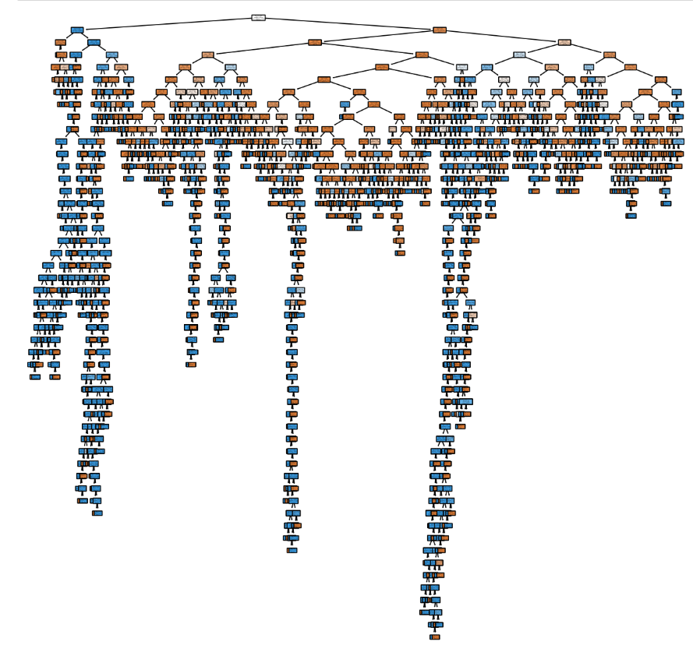
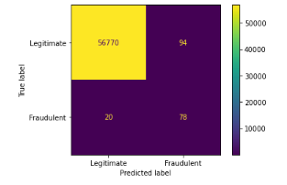
Baseline Decision Tree Model
The model was most likely overfitting and had a false positive rate of 0.00165 and a false negative rate of 3.5e-4.
Accuracy
Precision
Recall
99.8%
47
78
F1 Score
AUC
58
0.89

Slide 6
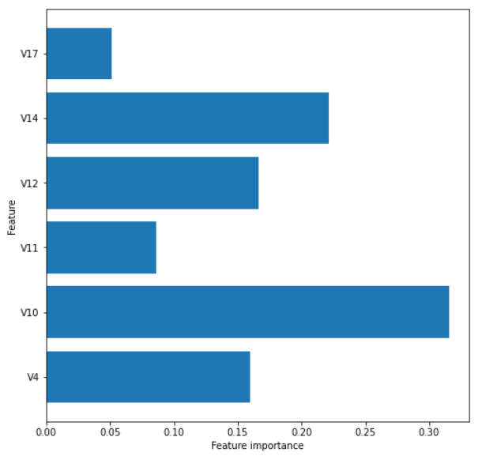
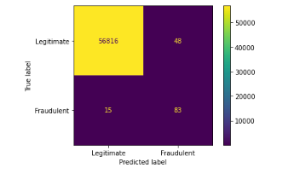
Pruned Random Forest Model
The model was less complex and had a false positive rate of 8.4e-4 and false negative rate of 2.6e-4.
Accuracy
Precision
Recall
99.9%
63
84
F1 Score
AUC
72
0.92

Slide 7
Impact of the Models | Conclusion
The pruned random forest model performed better than the baseline decision tree and was less complex.
Recommendation
It is recommended that the model be used in a cursory fashion to quickly flag transactions for further review. The role of the model is not to serve as the jury, judge, and executioner, but rather, serve as a tool for investigators to more efficiently review transactions and be the first line of defense against fraud.
Higher Performance
Reduced Complexity
Low False Negative Rate
Accuracy: 99.9%
Precision: 63
Recall: 84
F1 Score: 72
AUC: 0.92
The model was reduced from 30 features to just the six top performing features.
With less features, the model ran faster and was easier to evaluate.
When wrong, the model tends to lean toward false positive over false negative, which in the case of fraud is the more desirable outcome.

Slide 8
What more can be done to improve the model and combat financial fraud?
XGBoosting the random forest model could improve performance and neural networks can be utilized.
XGBoost
Extreme Gradient Boosting
Good for large data sets
Residual trees are built by calculating similarity scores
Neural Network
Utilizes interconnected nodes and hidden layers
Good for complex and large data sets

Slide 9

Thank you
Questions…

